Slide 1
Analysis of the Total Market General Infusion Pump data for the Job of Infusing Therapeutic Agents in a Hospital Setting
Analysis of nurse responses working with Adults & Paediatrics in the ICU, and Other Units

Slide 2
Respondent Demographics
 | Type of Nurse | # | %
S12b. Do you work on either a Medical-Surgical or in an Intensive Care Unit? If yes, which one? If no, indicate the unit in which you work. | Medical-Surgical – Adult | 124 | 37.20%
 | Medical-Surgical – Pediatric | 20 | 6.00%
 | ICU – Adult | 145 | 43.50%
 | ICU – Pediatric | 13 | 3.90%
 | No, other | 31 | 9.30%
Nurses that responded as “Other”: 10 different units represented
ER – 7
Cardiac: telemetry, testing, ICU, interventional
Birthing center – 2
Inpatient dialysis
Inpatient oncology
Imaging – 2
NICU
Outpatient clinic
Progressive care

Slide 3
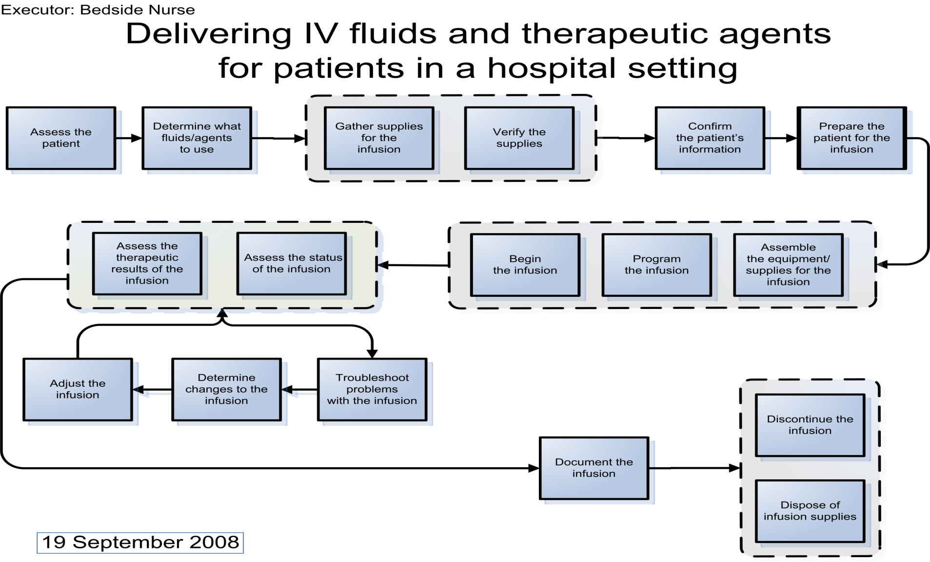
Total Market Opportunities Job Map

Slide 4
Step 1: Assess the Patient
Key Messages:
Pediatric nurses are especially concerned with minimizing trauma and/or adverse events for their patients. They are also very sensitive to the cycle time required to obtain information to assess whether the patient is responding to the therapy.
Extreme opportunity to ensure pediatric nurses have the alerts & available knowledge to determine if a given patient condition contraindicates the therapy.
Adult & pediatric nurses are both concerned with getting accurate data to assess patient needs.

Slide 5
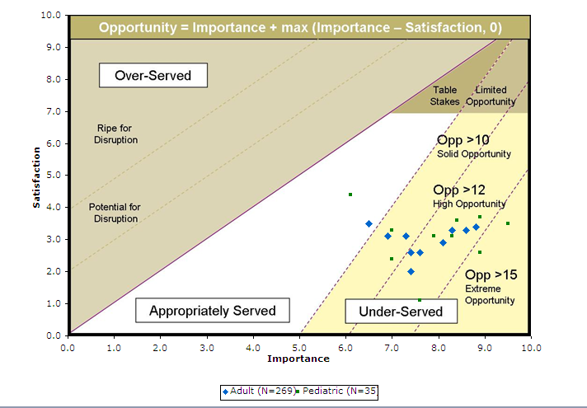
Step 1: Assess the Patient

Slide 6
Step 1: Assess the Patient
 | Adult (N=269) |  |  | Pediatric (N=35)
Outcomes | I | S | O | I | S | O
Minimize the likelihood that the determination of need is made incorrectly, e.g., due to incorrect lab results, incorrect interpretation, incorrect physical assessment, etc. | 8.8 | 3.4 | 14.2 | 9.5 | 3.5 | 15.5
Minimize the likelihood of being unaware of a patient condition that would contraindicate the administration of a specific fluid/agent. | 8.6 | 3.3 | 13.9 | 8.9 | 2.6 | 15.2
Minimize the amount of physical trauma to the patient when determining the need for infusion, e.g., pain, bruising, venous scarring, etc. | 8.3 | 3.3 | 13.3 | 8.9 | 3.7 | 14.1
Minimize the time required to obtain the results of measures used to determine the patient's need for infusion therapy, e.g., lab results, x-ray results, patient weight, etc. | 8.1 | 2.9 | 13.3 | 7.6 | 1.1 | 14.1
Minimize the likelihood that a measure required for the determination of the need for infusion therapy cannot be obtained | 7.4 | 2.0 | 12.8 | 8.3 | 3.1 | 13.5
Increase the likelihood of knowing whether key measures have been conducted, e.g., lab results, test results, etc. | 7.6 | 2.6 | 12.6 | 8.4 | 3.6 | 13.2
Minimize the time to obtain samples for lab measurements. | 7.4 | 2.6 | 12.2 | 7.9 | 3.1 | 12.7
Minimize the time required to determine if the patient's symptoms can be treated with infusion therapy, e.g., by reviewing their chart, previous infusions, the orders, medication guidelines, etc. | 7.3 | 3.1 | 11.5 | 7.0 | 2.4 | 11.6
Minimize the amount of variability in time that it takes to obtain the results of measures used to determine the patient's need for infusion therapy. | 6.9 | 3.1 | 10.7 | 7.0 | 3.3 | 10.7
Minimize the time required to assess the patient's condition when the responsibility for their care has been transferred, e.g., from shift to shift, ward to ward, hospital to hospital, etc. | 6.5 | 3.5 | 9.5 | 6.1 | 4.4 | 7.8

Slide 7
Related Jobs
Key Messages:
These are the other jobs the nurse is trying to get done while performing the job of infusing therapeutic agents
The nurses in the Adult units rated these opportunities higher then the nurses in Pediatric units
Of the 28 Social & Emotional Jobs, 14 are opportunities

Slide 8
Adjacent Jobs Total Market
 | Adult (N=269) |  |  | Pediatric (N=35)
Q2 - Adjacent Jobs | I | S | O | I | S | O
Address urgent patient care needs | 9.7 | 5.0 | 14.4 | 9.2 | 4.7 | 13.7
Ensure the comfort of the patient | 9.3 | 5.6 | 13.0 | 9.2 | 5.6 | 12.8
Learn about new medications | 8.6 | 4.5 | 12.7 | 8.4 | 4.5 | 12.3
Monitor other procedures being performed on the patient | 9.1 | 5.5 | 12.7 | 9.9 | 7.8 | 12.0
Learn about a medicine-related topic, e.g., a protocol | 8.2 | 4.6 | 11.8 | 9.3 | 6.7 | 11.9
Inform other medical personnel about the patient's status | 8.1 | 4.8 | 11.4 | 7.8 | 4.5 | 11.1
Educate the patient/family about the procedure being performed | 8.4 | 5.4 | 11.4 | 7.3 | 3.5 | 11.1
Educate patient/family members on care post discharge | 7.9 | 4.4 | 11.4 | 7.5 | 4.1 | 10.9
Document patient care not related to infusion therapy | 7.5 | 3.9 | 11.1 | 6.9 | 3.3 | 10.5
Field questions from patients/patient-caregivers | 7.8 | 4.5 | 11.1 | 7.9 | 5.3 | 10.5
Monitor other patients | 7.8 | 4.6 | 11.0 | 7.9 | 5.3 | 10.5
Coach/educate the patient | 7.8 | 4.8 | 10.8 | 7.8 | 5.4 | 10.2
Prepare the patient for other exams/procedures that will happen while on the current infusion | 7.6 | 4.5 | 10.7 | 7.7 | 5.6 | 9.8
Provide emotional support to the patient/family | 7.6 | 4.8 | 10.4 | 7.6 | 5.5 | 9.7
8

Slide 9
Adjacent Jobs Total Market
 | Adult (N=269) |  |  | Pediatric (N=35)
Q2 - Adjacent Jobs | I | S | O | I | S | O
Give other medications; e.g., oral, anal | 7.7 | 5.1 | 10.3 | 6.4 | 3.6 | 9.2
Assist the patient with mobility/ambulation | 6.7 | 3.6 | 9.8 | 6.2 | 3.6 | 8.8
Educate colleagues | 7.0 | 4.7 | 9.3 | 5.9 | 3.2 | 8.6
Ensure adequate stock of infusion supplies | 6.4 | 4.3 | 8.5 | 5.8 | 3.2 | 8.4
Transport the patient to other hospital departments | 5.6 | 3.6 | 7.6 | 5.1 | 2.5 | 7.7
Provide feedback regarding infusion equipment | 5.4 | 3.6 | 7.2 | 6.2 | 5.1 | 7.3
Plan patient discharge | 5.3 | 3.4 | 7.2 | 3.3 | 0.8 | 5.8
Field questions from colleagues about other patients | 5.5 | 3.9 | 7.1 | 4.1 | 2.6 | 5.6
Prepare the equipment for the next use, e.g., maintain it, test it, replenish supplies/power, etc. | 5.1 | 3.2 | 7.0 | 4.1 | 2.7 | 5.5
Clean the infusion equipment | 5.3 | 3.9 | 6.7 | 3.8 | 2.7 | 4.9
Field phone calls and handle pages | 4.6 | 2.9 | 6.3 | 3.7 | 2.5 | 4.9
Help get supplies for other nurses | 4.9 | 3.6 | 6.2 | 3.1 | 1.3 | 4.9
Monitor pages | 4.5 | 3.2 | 5.8 | 3.6 | 2.9 | 4.3
Track infusion system inventory | 3.4 | 2.9 | 3.9 | 3.3 | 5.2 | 3.3
9

Slide 10
Social & Emotional Jobs
Key Messages:
Of the 21 Social & Emotional Jobs, 20 are important opportunities (over half of them are extreme)
Notes:
Importance is rated for Social & Emotional Jobs
Satisfaction is not rated
The importance was the same for both nurses in Adult & Pediatric units in the hospital

Slide 11
Social & Emotional Jobs Total Market
Social & Emotional Jobs | Importance | Opportunity | Rank
Be perceived as trustworthy | 9.8 | 19.6 | 1
Be perceived as protecting the patient's safety | 9.4 | 18.8 | 2
Be perceived as competent | 9.3 | 18.6 | 3
Be perceived as knowledgeable | 9.0 | 18.0 | 4
Be perceived as caring | 8.9 | 17.8 | 5
Avoid feeling disorganized | 8.8 | 17.6 | 6
Be perceived as sincere | 8.7 | 17.4 | 7
Be perceived as collaborative | 8.5 | 17.0 | 8
Be perceived as up to date | 8.5 | 17.0 | 9
Avoid feeling frustrated | 8.0 | 16.0 | 10
Avoid feeling a sense of mistrust | 7.9 | 15.8 | 11
Avoid feeling inadequate | 7.7 | 15.4 | 12
Avoid feeling stressed | 7.3 | 14.6 | 13
Avoid feeling irritated | 7.2 | 14.4 | 14
Be perceived as happy in my job | 7.1 | 14.2 | 15
Feel a sense of accomplishment | 7.0 | 14.0 | 16
Avoid feeling stupid | 7.0 | 14.0 | 17
Avoid feeling uncomfortable/insecure | 6.9 | 13.8 | 18
Feel appreciated | 5.6 | 11.2 | 19
Avoid feeling embarrassed | 5.5 | 11.0 | 20
Avoid being perceived as a servant | 3.6 | 7.2 | 21
11

Slide 12
Thank You

